Slide 1
ISA Sport Development
Aussie Skate Membership Registration Database
And could we have a national database?

Slide 2
Aussie Skate Membership Registration – Uplifter
At the end of last year Register Now ceased, requiring a new membership registration program.
After some investigation we came upon Uplifter.
Uplifter provides member management software for clubs, schools and associations. They are a Canadian company who started through figure skating in Canada.
As well as figure skating it is providing services to gymnastics, athletics, soccer, cheerleaders and various types of camps (music, training).
https://www.uplifterinc.com/

Slide 3
Aussie Skate Membership Registration – Uplifter
https://www.uplifterinc.com/

Slide 4
Aussie Skate Membership Registration - Uplifter
So what does it cost?
It is $29US per month for ISA to utilize Uplifter to manage our Aussie Skate Registrations.

Slide 5
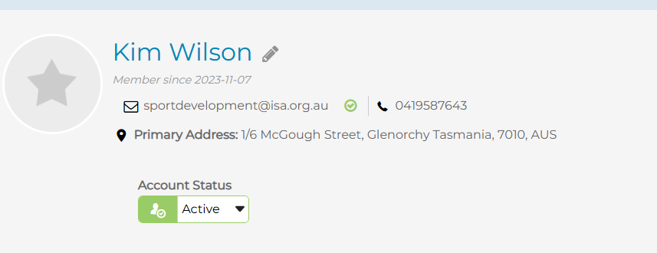
Aussie Skate Membership Registration - Uplifter
How does it work for members?
Members create an account. This account has a login (email) and password.

Slide 6
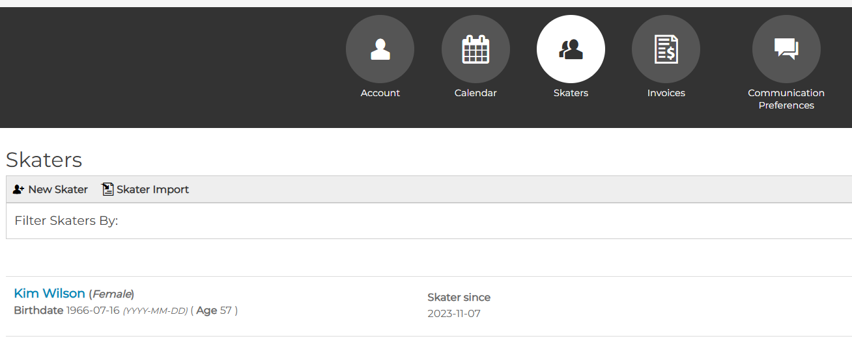
Aussie Skate Membership Registration - Uplifter
Skaters are listed under the account. If a parent has more than one child, they can set up all those skaters under the one account and pay those membership registrations under one transaction.

Slide 7
Aussie Skate Membership Registration - Uplifter
The member once they have paid for the memberships will receive an invoice. These invoices can be tailored to include whatever information is required eg links to the Aussie Skate App and promocode
For anyone who is having problems with registration, an Administrator for the account can send reset password links or generate an invoice for payment. If there is an overpayment, a refund can be issued.

Slide 8
Aussie Skate Membership Registration - Uplifter
What is it’s potential?
At the moment we only are using for Aussie Skate but it does have the potential to be a national database that states could utilize to manage their own membership registrations.
As an example we have set up a specific page for FSAT which has it’s own address. You can create as many registration categories that you require.

Slide 9
Aussie Skate Membership Registration - Uplifter
What are the benefits to ISA Members?
If our ISA members decided to use Uplifter under the ISA account some of the benefits are:
Cost savings for ISA members (financial and time)
Becomes our National database
Members have their own account and a parent of more than one child can put all their kids under the one account
Skaters can update their details directly in Uplifter themselves – we then have their latest contact details
Track skater development via recording of test levels
Ability to obtain up to date reports
Will assist with knowing where our sport is at a glance (skater numbers)
If skaters change states ISA members can check current test records or financial reliability (“of good standing”)
Assist competition convenors to check skater levels and other relevant information
For those running Aussie Skate program has the ability to run group testing
Ability to send out membership renewal notices

Slide 10
Aussie Skate Membership Registration - Uplifter
Payment Processing and Administration
With regards payments, these can be done via a Stripe account for each individual state that chooses to use Uplifter to take their payments.
If an ISA member decided to use Uplifter to manage their memberships, then a nominated representative of that member would get administrative access to be able to manage skater records and access reports. That nominated representative would have their own Uplifter account.

Slide 11
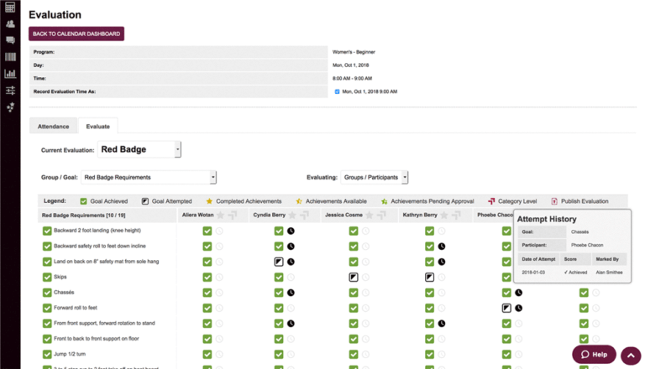
Aussie Skate Membership Registration - Uplifter
Keeping track of skaters
For Rinks or clubs running Aussie Skate, it has the potential to record evaluations for individual skaters.
This could also be applied to ISA tests. For example you would select the test level and then tick off each part of a pattern test. This way you can track pass or fails of tests. It could also be used to identify if a skater has to repeat a particular pattern.

Slide 12
Aussie Skate Membership Registration - Uplifter
Keeping track of skaters
For Rinks or clubs running Aussie Skate, it has the potential to record evaluations for individual skaters.
This could also be applied to ISA tests. For example you would select the test level and then tick off each part of a pattern test. This way you can track pass or fails of tests. It could also be used to identify if a skater has to repeat a particular pattern.

Slide 13
Aussie Skate Membership Registration - Uplifter
If you click on the name of the skater it will take you to a selection. Here you can check skater’s Achievements or enter in an Evaluation.

